Slide 1
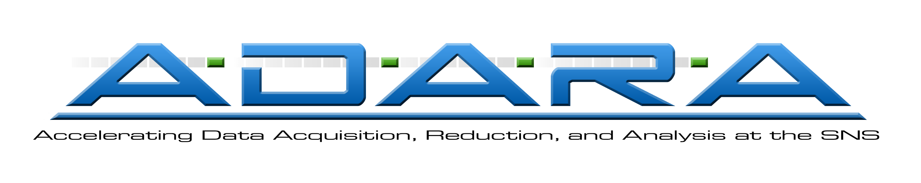

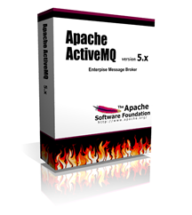

Automated data processing using Mantid at the SNS
Shelly Ren, Peter Peterson, Ashfia Huq, Andrei Savici, Mathieu Doucet
Oak Ridge National Laboratory, Oak Ridge, Tennessee, USA
Motivation:
Status:
With the increased data rates of newer time-of-flight neutron spallation sources processing data is becoming a bottleneck in the experiment, especially for traditionally high-throughput instruments
A special feature of these instruments is that the data reduction generally can be configured before the data is acquired
Enabling automated data reduction at the end of each run would produce reduced data promptly via well defined Mantid API and allow instrument scientists to focus on new science
Process|run.sh
STS
NFS
inotify
NX cataloging
NX cataloging
HTTPS
pre-ADARA
autoreduce
ICAT server
Objectives:
NFS
autoreduce
Use Mantid software to automatically reduce the experiment data
Provide users with access to reduced data files almost immediately after acquisition
Catalog raw data and reduced data in ICAT database
Provide Mantid users with path to reduced data for data analysis and visualization via ICAT web service
TS
HTTPS
reduced data cataloging
reduced data cataloging
Post Processing Workflow in Production
Approach:
Automated data reduction currently running on seven SNS beamlines: ARCS, BASIS, HYSPEC, NOMAD, POWGEN, REF_L, REF_M, and SEQUOIA.
ADARA post processing system including automated data reduction currently running on HYSPEC concurrent with the existing data system infrastructure.
Phase 1: pre-configure data reduction parameters before experiment data is acquired
Identified POWGEN, a high throughput instrument, as the first instrument to test the automated data reduction framework
Met with instrument scientist to determine parameters necessary for data reduction.
Developed a reduction script to invoke an existing Mantid Python algorithm SNSPowderReduction with input parameters confirmed by the instrument team and data reduction team
Enabled instrument teams to modify the auto reduction script with the updated parameters for the experiment
Built an overall post processing workflow to catalog and auto reduce data
Deployed the post processing suite into production for POWGEN and received positive remarks from users, in particular, the system served mail-in samples well
Leveraged the automated reduction techniques used in POWGEN together with the well defined Mantid data reduction algorithms to additional instruments including ARCS, BASIS, HYSPEC, NOMAD, POWGEN, REF_L, REF_M, and SEQUOIA
Revised the post processing workflow to work with the newly developed streaming data flow of the ADARA project
Phase 2: Metadata driven data reduction approach
Realize the full potential of the ICAT system: define much of the core metadata that should be captured in the database to achieve the design and development of metadata-driven data reduction
Take advantage of the on-going ADARA project to transmit core metadata from DAS to NeXus to ICAT, and unleash the power of metadata to fully automate data processing
Next Step:
ActiveMQ
brokers
NX cataloging
STS
ActiveMQ
brokers
NX cataloging
PFS
POSTPROCESS.DATA_READY
CATALOG.DATA_READY
CATALOG.STARTED
CATALOG.COMPLETE
autoreduce
ICAT server
autoreduce
WM makes sure that every run goes through the full processing
REDUCTION.DATA_READY
REDUCTION.STARTED
REDUCTION.COMPLETE
Reduced data cataloging
Workflow Manager
Reduced data catloging
Messaging legend:
Message received
Message sent
Workflow Manager
Reporting DB
POSTPROCESS.DATA_READY
CATALOG.STARTED
CATALOG.COMPLETE
REDUCTION.STARTED
REDUCTION.COMPLETE
REDUCTION_CATALOG.STARTED
REDUCTION_CATALOG.COMPLETE
CATALOG.DATA_READY
REDUCTION.DATA_READY
REDUCTION.COMPLETE
REDUCTION_CATALOG.DATA_READY
REDUCTION_CATALOG.STARTED
REDUCTION_CATALOG.COMPLETE
REDUCTION.NOT_NEEDED
Post Processing Workflow in Development
ADARA post processing workflow with ActiveMQ in place running on HYSPEC and subsequent beam lines that are transitioned to ADARA path
Integrate ICAT4.2 into Mantid to enable reduced datafile search
Meta data driven data reduction to minimize or eliminate pre-configuring data reduction parameters and to unlock the full potential of the ICAT system
* ADARA (Accelerating Data Acquisition, Reduction, and Analysis) is a new streaming data flow architecture in development at SNS to give users nearly “instant” access to data, and to provide the foundation for future live data analysis and steering/optimization of experiments
Disclaimer information
ORNL is managed by UT-Battelle, LLC, under contract DE-AC05-00OR22725 for the U.S. Department of Energy.

